Slide 1
Welcome to The Valley School’s KS4 Information Evening

Slide 2
KS4
Options
Preparing for post 16
Maths and English
PSHE, Careers

Slide 3
Options in Year 10 and Year 11

Slide 4
What are the Pathways?
3 Vocational Routes
Diploma
Certificate
Award
4 core units
6 option units
2 core units
3 option units
1 core unit
2 option units
4 assessments
2 assessments
6 assessments
4 assessments
12 assessments
8 assessments
Notes:
Check that the assessment amounts are correct.

Slide 5
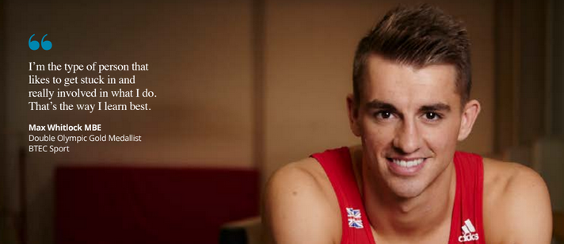
Options linked to a BTEC qualification
Hospitality - Catering
Art and Design
Performing Arts
DT- Plumbing
Childcare- H&SC

Slide 6
NCFE accreditations
Life skills Option’s

Slide 7
Other accreditations
Duke of Edinburgh: https://www.dofe.org/do/
Sports leadership: https://www.sportsleaders.org/qualifications-programmes/sports-leadership

Slide 8
Forest School

Slide 9
English and Maths
Your child is also working towards a Functional skills qualification in English and Maths

Slide 10
Preparing for Post 16 curriculum

Slide 11
What are the Pathways?
Your child’s pathway is personal to them
Bridie McDonald

Slide 12
How these pathways prepare them for Post 16 (KS5)
Each pathway is to help your child become confident in their next steps

Slide 13
Future progression
There are many routes available to your child
College: Jess Underwood (Transition Support Worker) from North Herts College works closely with us to look at various routes
Other local college open days and link transition workers are available
Work based learning routes: Apprenticeships

Slide 14
What can you do to help?
Talk to your child about their interests, career ideas etc...
Start looking at open events at the local colleges
Talk to us. We are here to help with any questions or concerns you may have

Slide 15
Any questions?

